Slide 1
Review of Multi View Super Vector
^{Student Name Justin Baraboo}
^{Student ID 16204977}
^{Email:jjbkb4@mail.umkc.edu}

Slide 2
We are fusing together 2 Features
Overview
CCA, PCCA, MPCCA
Multi-View Super Vector
Experiment
Results

Slide 3
Rich Environment of Features
Sift Points
Histogram of Oriented Gradients (HoG)
Color Histogram
Histogram of Optimal Flow (HoF)
Motion Boundary Histogram (MBH)
Spatio Temporal Interest Points (STIP)

Slide 4
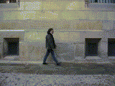
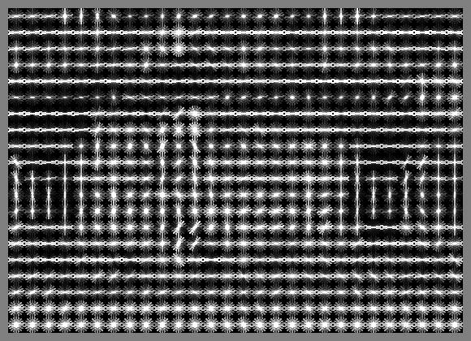
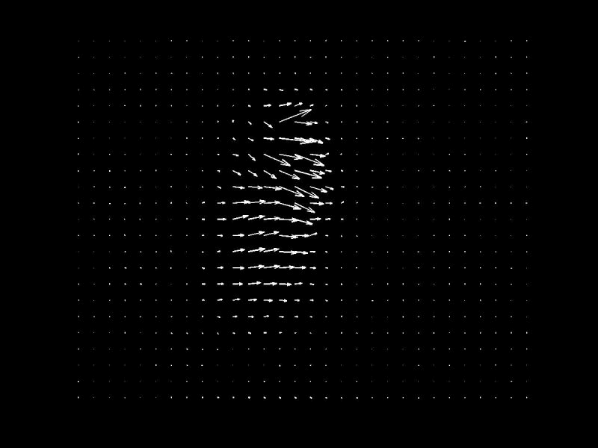
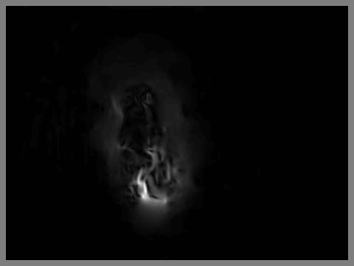
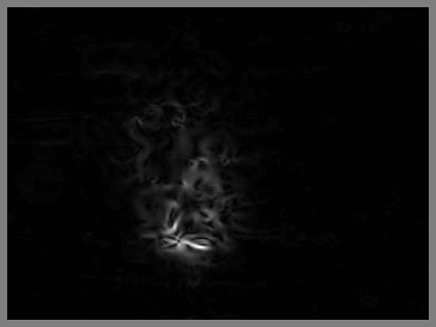
*Video from chalearn looking at people chanllenge
HOG
HOF
MBHx/MBHy
Static
Dynamic
Taken from Zhuowei Cai’s Ppt

Slide 5
How do we use these features?
Combining features outperforms a single feature model.
But how do we combine?
Different Level Based tactics

Slide 6
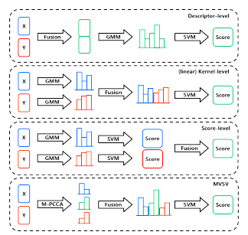

Slide 7
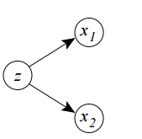
Canonical Correlation Analysis
For data sets X, Y, find a set of linear projections to maximize correlation of aX and bY.
Make probabilistic by
Introducing Latent factor
Z
“A Probabilistic Interpretation of Canonical Correlation Analysis” F. R. Bach and M. I. Jordan.
Technical Report 688, Department of Statistics, University of California, Berkeley, 2005.

Slide 8
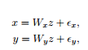
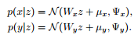
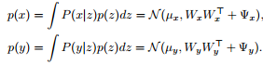
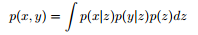
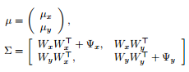
PCCA Mathematical Formulation

Slide 9
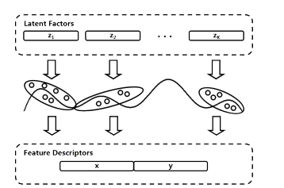
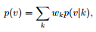
M-PCCA

Slide 10
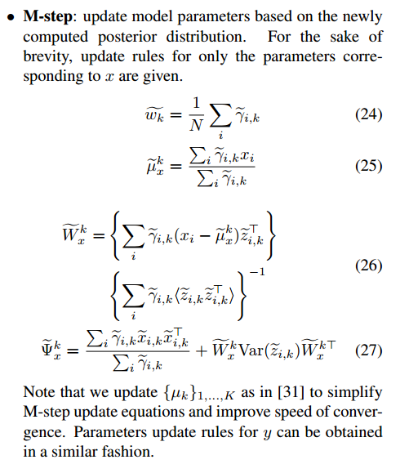
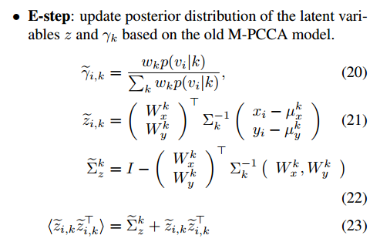
Learning with M-PCCA

Slide 11
Multi-View Super Vector
Latent Factors Z and gradient vector G of complete log likelihood.
Latent Factor encodes Shared Information
Gradient Vectors Gx, Gy encode Private Information with λx λy

Slide 12
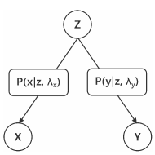

Slide 13
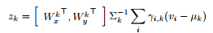
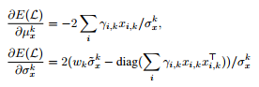
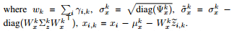
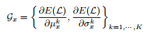
Mathematically

Slide 14
“The Most Important Slide”
If weighting coefficients are set to 0 for all except nearest mean it is set to 1, we get VLAD with PCA
Gradient encodes direction in which parameters should be stretched, making it very close to Fisher Vector
MVSV encodes less redundant information

Slide 15
Experiment
Looked at HMDB51 and UCF101 Databases
3 Features: HoG, HoF, MBH
PCA’d and L2-normalized
Must define: latent space dimension, number of components. (45 and 16-512)

Slide 16
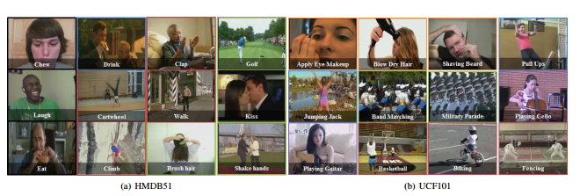

Slide 17
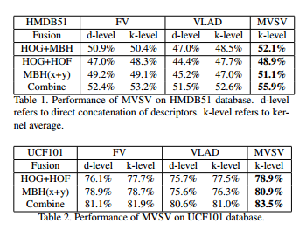
Result

Slide 18
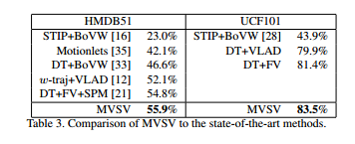

Slide 19
But….
Only easy to do for 2 features

Slide 20
References
“Multi-View Super Vector for Action Recognition” Zhuowei Cai, Limin Wang, Xiaojiang Peng, Yu Qiao. IEEE Conference on Computer Vision and Pattern Recognition (CVPR) 2014.
“A Probabilistic Interpretation of Canonical Correlation Analysis” F. R. Bach and M. I. Jordan. Technical Report 688, Department of Statistics, University of California, Berkeley, 2005.

